Slide 1


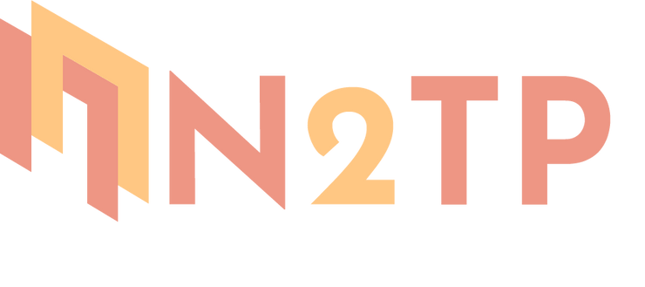

Multi-objective Reinforcement Learning for Optimizing JAK/STAT3 Pathway Interventions: A Computational Simulation Study
Nhung Duong, Tuan Do, Tien Nguyen, Hoa Vu, Lap Nguyen
From Hanoi University of Pharmacy, Vietnam
Presenter: Nhung Duong

Slide 2
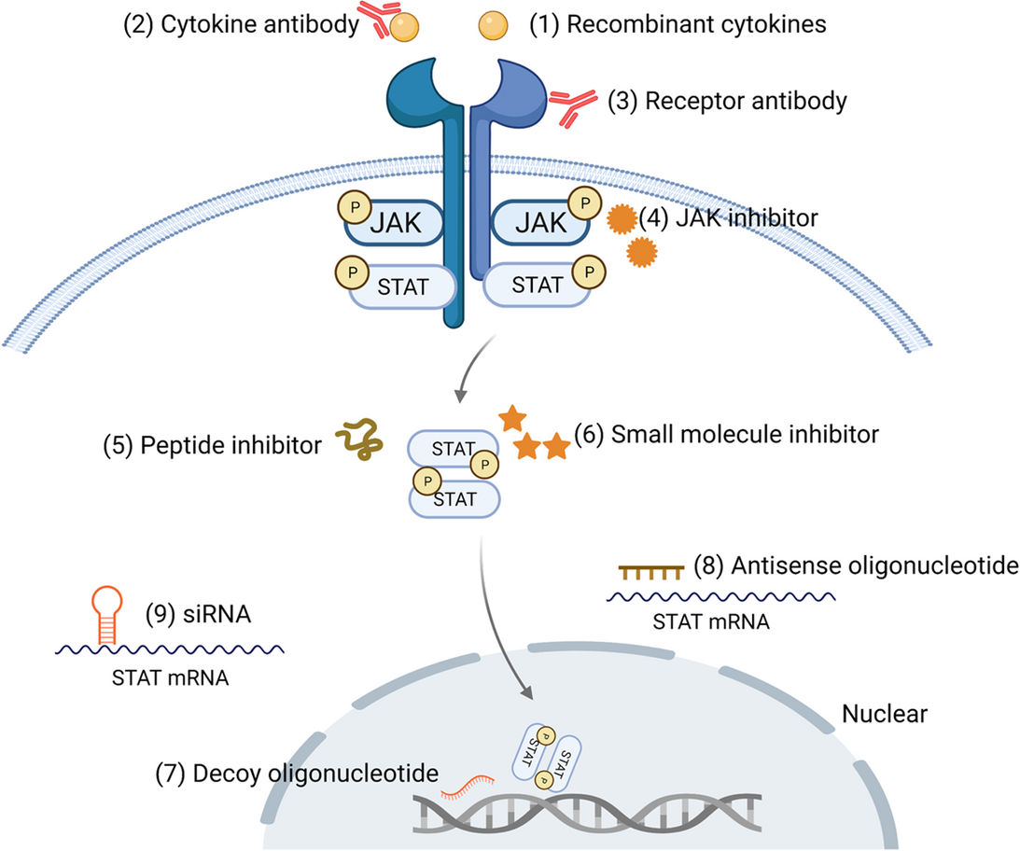
Background & Motivation
Drugs targeting JAK/STAT
  Cytokine or receptor antibodies
  JAK inhibitors
  STAT inhibitors
Figure from Hu, X., et al. Sig Transduct Target Ther 6, 402 (2021)
1

Slide 3
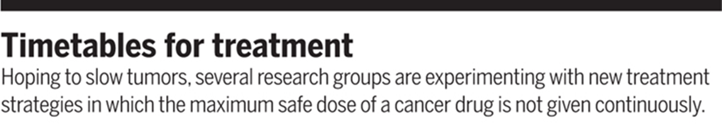
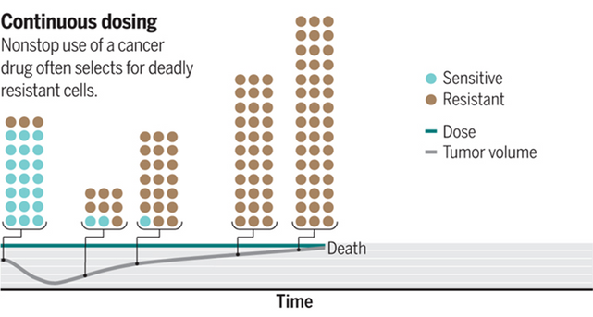
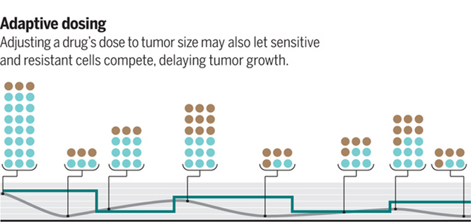
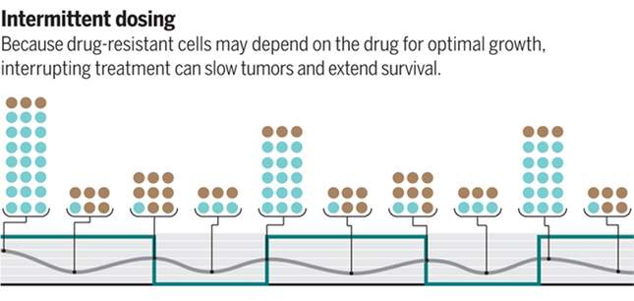
Background & Motivation
Challenges related to effective cancer treatment
  How combine effectively and safely?
  Because large number of potential drug combinations, variety of dosing schedules and sequences.
  Identifying the optimal treatment regimen among the countless possibilities seems an unreachable goal when using the standard empirical methods
2
Jocelyn Kaiser. Science 355,1144 1146(2017)

Slide 4
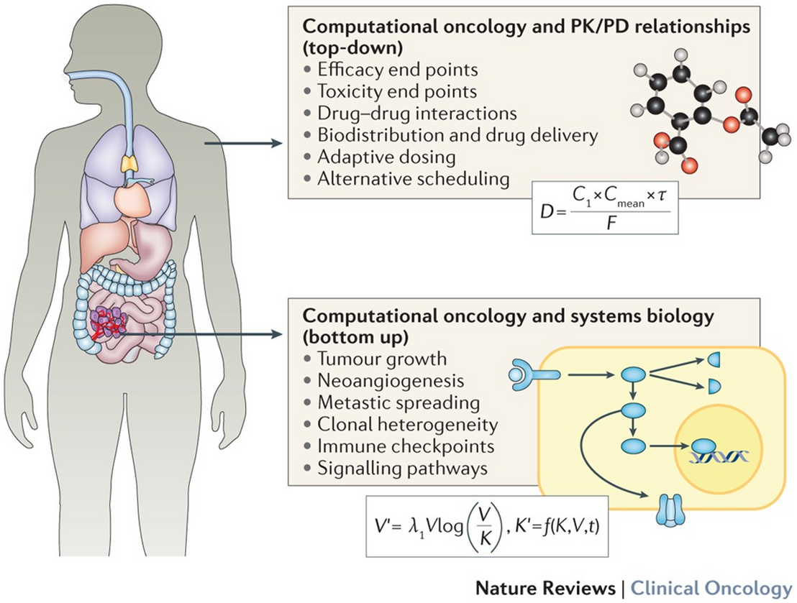
Background & Motivation
Computational approach to explore and screen Tx strategies
  Mechanistic models aim to investigate tumour biology (tumour growth, angiogenesis, metastasis, drug resistance...)
  PK/PD modelling to refine scheduling and dosing of anticancer
Methodological challenges: optimize multiple objective values simultaneously, represent different aspects of cancer Tx [Efficacy, Immune, Resistance, Toxicity]
Figure from Barbolosi, D., et al. Nat Rev Clin Oncol 13, 242–254 (2016)
3

Slide 5
Background & Motivation
A computational framework that applies multi-objective reinforcement learning to explore the JAK/STAT3 signaling network and identify promising intervention strategies
4

Slide 6
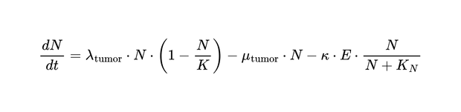
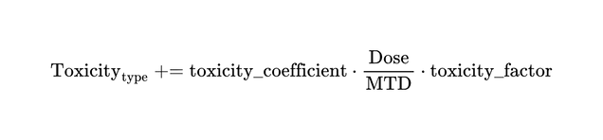
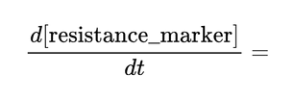
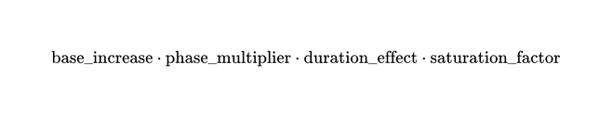
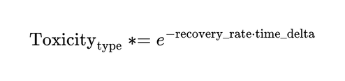
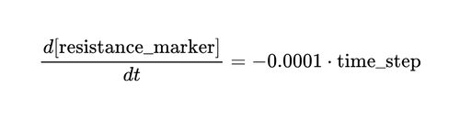
QSP Model
JAK/STAT Pathway Model
Cell Population Model
Intervention Model
System of ODE model:
  Ligand dynamics
  Receptor dynamics
  Ligand-receptor complex
  Receptor dimer
  JAK activation
  Active receptor-JAK complex
  STAT3 dynamics
  Phosphorylated STAT3
  STAT3 dimer in cytoplasm
  STAT3 dimer in nucleus
  mRNA and protein dynamics for target genes
Tumor-Immune Dynamical Model
PK/PD Model
  Incorporated cellular behaviors influenced by the JAK/STAT3 pathway outputs
  Consisted of Proliferation rate, Apoptosis rate, T cell dynamics, T cell killing rate, and T cell exhaustion dynamics:
  PK: One-compartment
  PD incorporated JAK inhibitor effect on JAK activation rate, STAT3 inhibitor effect on STAT3 phosphorylation, and cytokine blocker effect for ligand dynamics
Toxicity Model
Resistance Development Model
Toxicity Recovery Over Time:
During treatment off-periods, resistance declines passively:
5

Slide 7
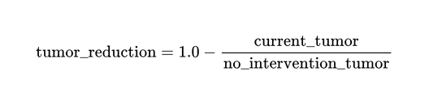
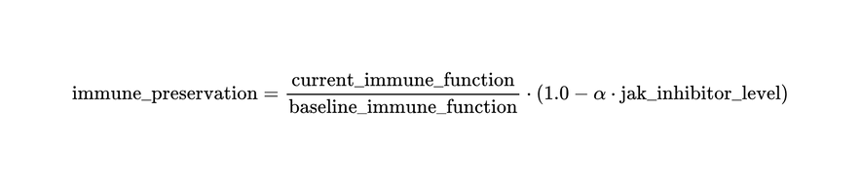
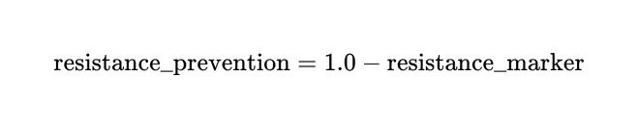
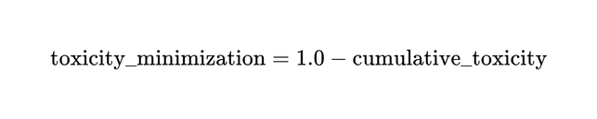
Objective Definition and Rationale
Definition
Tumor-Immune Dynamical Model
Rationale
Tumor-Immune Dynamical Model
  Clinical reality: Four objectives reflect real competing priorities in cancer therapy (efficacy vs. safety vs. resistance)
  Balanced optimization: [0,1] normalization prevents single metric dominance in reward function
  Pareto exploration: Five weight configurations systematically explore trade-offs between conflicting goals
  True efficacy: Tumor reduction vs. no-intervention baseline ensures rewards reflect treatment impact, not natural progression
  Addresses failure modes: Each objective targets specific clinical challenges (resistance, immunosuppression, toxicity discontinuation)
Resistance Prevention
Toxicity Minimization
Weight
  Balanced: w = [0.25, 0.25, 0.25, 0.25]
  Efficacy-focused: w = [0.7, 0.1, 0.1, 0.1]
  Immune-preserving: w = [0.1, 0.7, 0.1, 0.1]
  Resistance-preserving: w = [0.1, 0.1, 0.7, 0.1]
  Toxicity-minimizing: w = [0.1, 0.1, 0.1, 0.7]
6

Slide 8
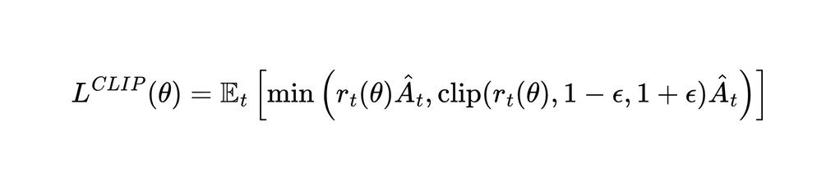


RL Methodology
Multi-objective Proximal Policy Optimization
A multi-objective reinforcement learning approach was implemented based on Proximal Policy Optimization (PPO)
The algorithm maintained 2 neural networks:
  Policy network πθ(a|s): Outputs action probabilities given the current state
  Value network Vϕ(s): Estimates the expected vector of rewards for each state
The PPO objective function for policy optimization is:
RL Training Parameters
  Environment: 100-day episodes using integrated mechanistic model as simulation environment
  State space: 32-dimensional vector
  Action space: Discrete multi-dimensional choice of 3 intervention types (JAKi, STAT3i, IL-6 antibody) combined with 5 dose levels (0-100% MTD)
  Training scale: 1,000,000 total environment steps
  Algorithm parameters: PPO with discount factor γ=0.99, learning rate 3×10⁻⁴
  Multi-objective approach: 5 distinct agents trained with different reward weight configurations to explore Pareto front
  Episode structure: Daily action selection over 100-day treatment periods
Where:
- is the probability ratio between the new and old policy
- is the advantage estimate, computed for each objective dimension
- is the clipping parameter (typically 0.1 or 0.2)
7

Slide 9
Sensitivity Analysis
One-At-a-Time (OAT) Analysis
PRCC Analysis
For each parameter θ, we defined a range of variation:
  Core pathway parameters: Varied by ±10%, ±20%, and ±50%
  Pharmacokinetic parameters: Varied by ±10%, ±20%, and ±50%
  Pharmacodynamic parameters: Varied by ±10%, ±25%, and ±75%
  Toxicity parameters: Varied by ±10%, ±30%, and ±60%
Each parameter was varied independently while all others were kept at their baseline values
  Generated 1000 param sets using Latin Hypercube Sampling
  From the LHS results, we calculated PRCC values to quantify the strength and direction of monotonic relationships while controlling for the effects of other parameters. The calculation involved:
    Ranking the parameter values and outcome metrics
    Computing the correlation matrices between parameters and outcomes
    Calculating partial correlation coefficients using these rank correlation matrices
Sobol Analysis
Why Sensitivities?
  Model confidence: Validates which of parameters actually drive outcomes
  Robustness: Ensures RL strategies aren't artifacts of specific parameter choices
  Biomarkers: Identifies parameters for patient stratification
  Priorities: Guides which parameters need experimental validation
  Future RL reward design: Informs parameter-aware reward design
We computed first-order (S1) and total (ST) Sobol indices using the SALib Python package. We generated 10,000 parameter samples using Saltelli's sampling scheme and simulated the model for each parameter set.
The indices were calculated for each of the four objective metrics.
8

Slide 10
Result & Discussion
Reinforcement Learning Outcomes
9

Slide 11
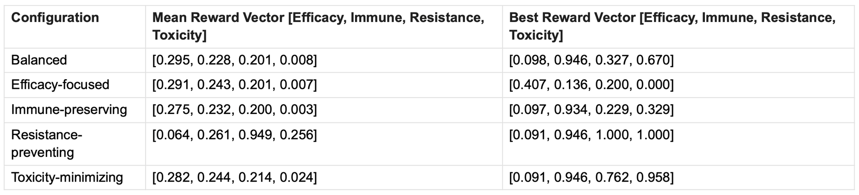
Result & Discussion - RL Outcomes
Attaining high performance in four objectives simultaneously seems impractical
Performance summary for different objective weight configurations:
  Trade-off: Differences between the mean and best reward vectors => inherent conflicts between objectives
  Objective Prioritization: Weight configurations <-> Emphasized objectives
  Toxicity Challenge: Toxicity minimization consistently showed the lowest values
  Exceptional Solutions: Notable strategy [resistance prevention and toxicity minimization
  Immune-Tumor Coupling: High immune preservation with limited tumor reduction
10

Slide 12
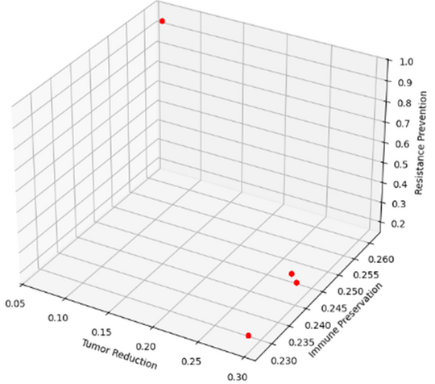
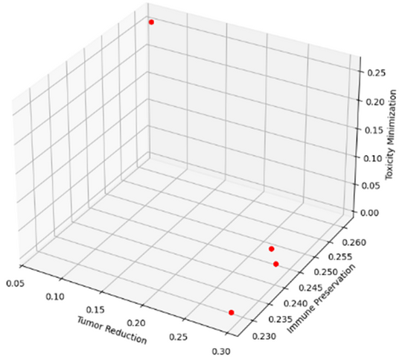
Result & Discussion - Pareto
But we can identify a set of optimal intervention strategies
Clustered strategies in distinct regions of the objective space, representing qualitatively different treatment paradigms:
  High Immune Preservation Cluster: immune preservation values >0.94 with limited tumor reduction (0.05-0.10) but varied considerably in resistance prevention (0.2-0.95) and toxicity minimization (0.25-1.0).
  High Tumor Reduction Cluster: achieved tumor reduction values >0.25, but sacrificed resistance prevention (≤0.2) and toxicity profiles (≤0.02).
  Balanced Strategies: Achieved moderate performance across all objectives (all values ~0.2-0.3).
  Exceptional Points: Outlier strategies achieved near-optimal performance in three objectives simultaneously, especially scoring perfectly on resistance prevention and toxicity minimization.
11

Slide 13
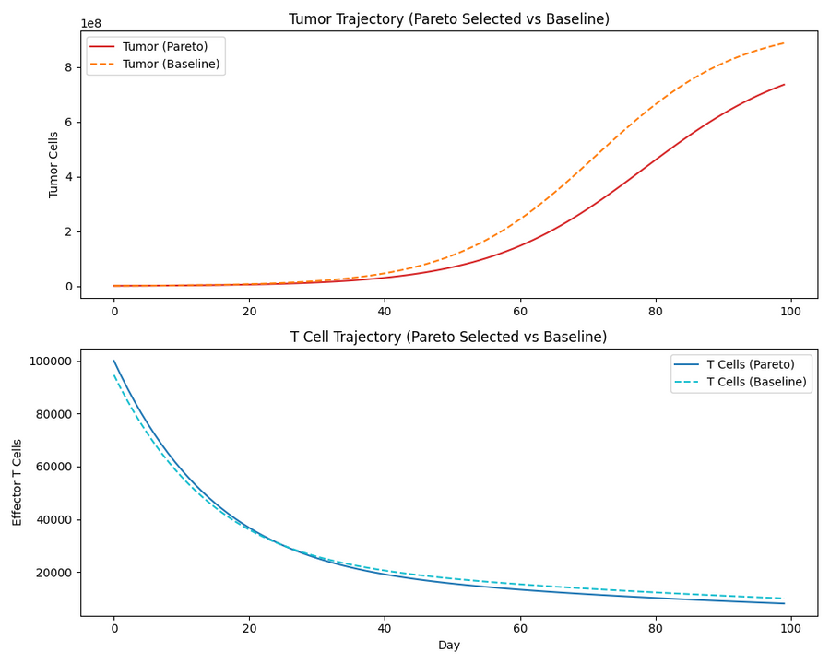
Result & Discussion - Pareto Optimal
Tumor-reduction prioritizing strategy
The intervention schedule consisted of:
  Moderate-dose JAK inhibitor (~40% MTD)
  High-dose STAT3 inhibitor (~90-100% MTD)
  Pulsed low-dose cytokine blocker with regular drug holidays
This strategy [0.282, 0.244, 0.214, 0.024] balanced moderate tumor reduction with reasonable immune preservation while accepting higher toxicity as a trade-off
  28% reduction in tumor volume compared to baseline after 100 days of treatment
  T cell counts were maintained at approximately 24% of baseline levels after adjusting for JAK inhibitor effects
  Significant cumulative toxicity
12

Slide 14
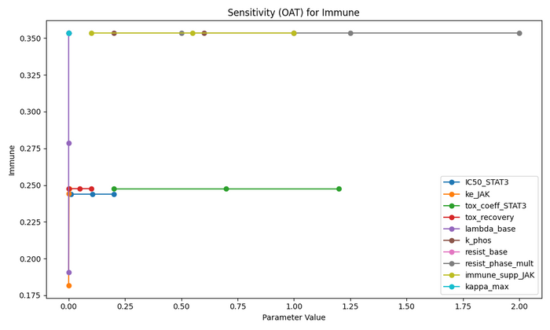
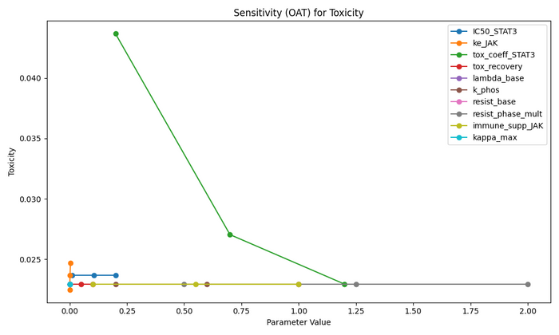
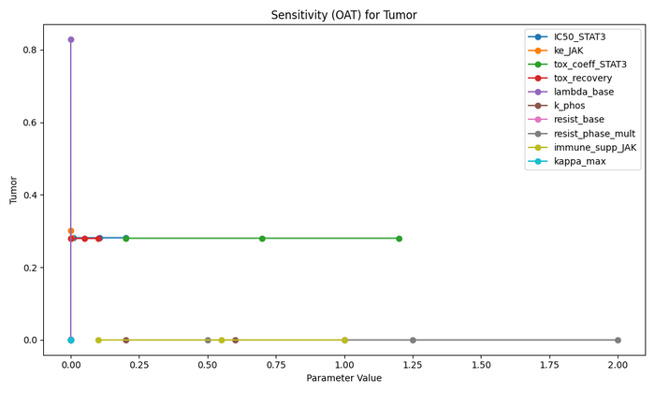
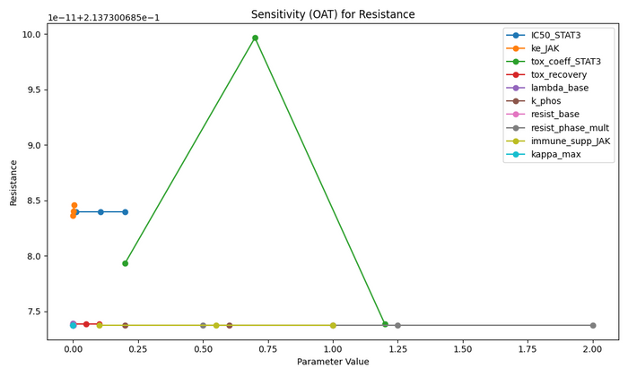
Result & Discussion - Pareto Optimal
Tumor-reduction prioritizing strategy - One-At-a-Time (OAT) sensitivity analysis
  Tumor reduction - most sensitive to baseline tumor proliferation rate, with higher values dramatically improving control.
  Immune preservation was primarily influenced by JAK inhibitor immune suppression factor and resistance phase multiplier, with elimination rate showing moderate impact.
  Resistance prevention showed non-monotonic response to STAT inhibitor toxicity coefficient, peaking at intermediate values.
  Toxicity minimization was predominantly controlled by STAT inhibitor toxicity coefficient, with higher values paradoxically improving scores through complex parameter interactions.
The Pareto-optimal strategy is robust to most parameter variations, though patient-specific tumor growth and STAT inhibitor response factors could significantly impact outcomes.
13

Slide 15
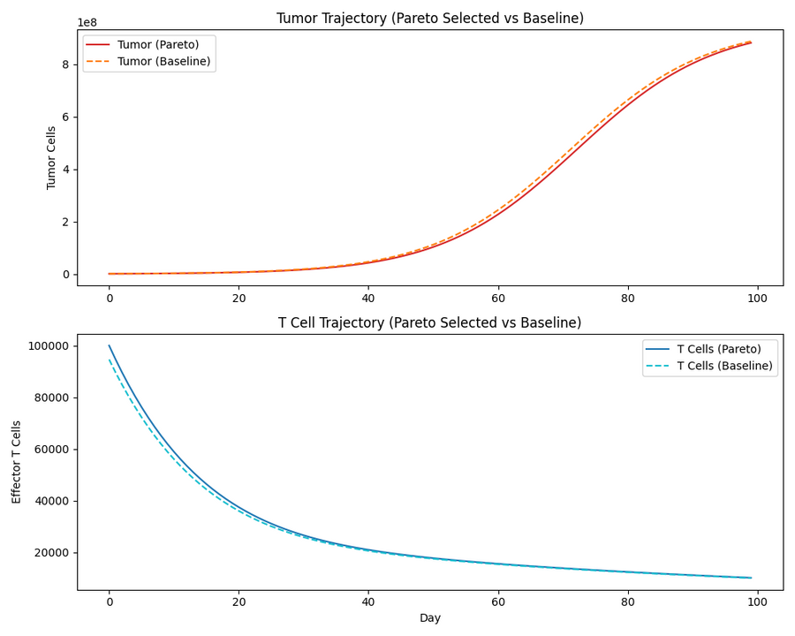
Result & Discussion - Pareto Optimal
Resistence prevention prioritizing strategy
The intervention schedule consisted of:
  Minimal JAK and STAT3 inhibition with pulsed very low-dose cytokine blocker administration
This strategy [0.064, 0.261, 0.949, 0.256] exchanged tumor control for exceptional resistance prevention
  Prevented the emergence of resistant cell populations (0.949 score)
  Maintained better toxicity profile (0.256 vs 0.024)
  Achieved slightly better immune preservation (0.261 vs 0.244)
  Sacrificed significant tumor control (only 6.4% reduction)
14

Slide 16
Result & Discussion
QSP Model Sensitivity Analyses
15

Slide 17
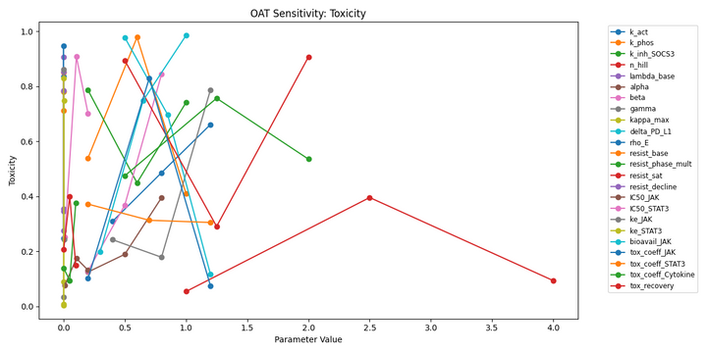
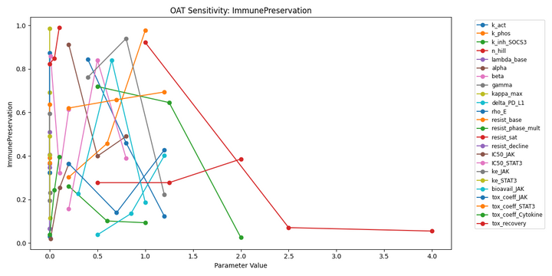
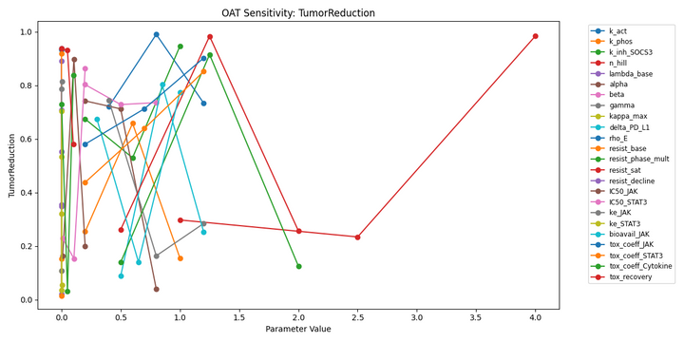
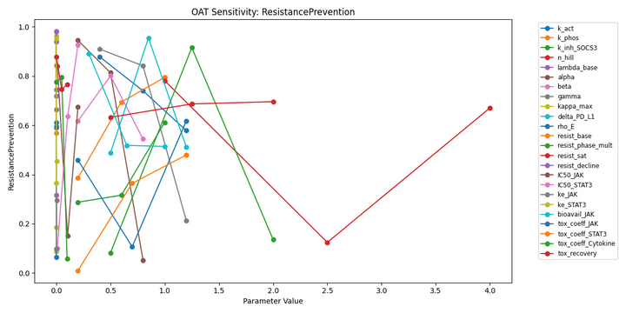
Result - Sensitivity of QSP Model
Key parameters that significantly influence treatment outcomes
One-At-a-Time Analysis:
  Immune preservation was most sensitive to SOCS3 inhibition rate and resistance saturation
  Resistance prevention showed significant sensitivity to SOCS3 inhibition rate and base resistance development rate
  Toxicity outcomes were particularly influenced by toxicity recovery rate and JAK inhibitor bioavailability
  Tumor reduction was most affected by toxicity recovery rate and JAK activation rate
16

Slide 18
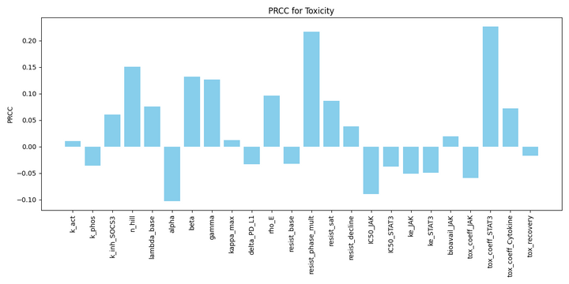
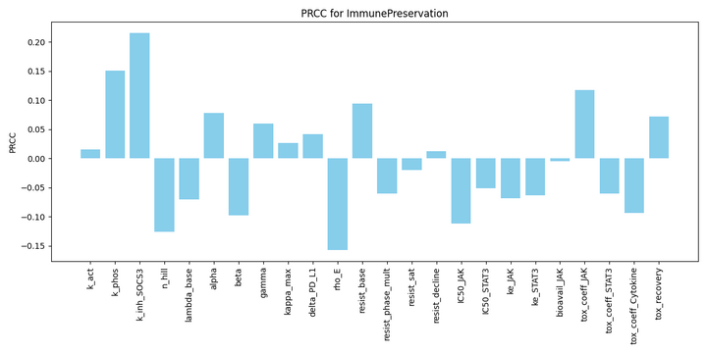
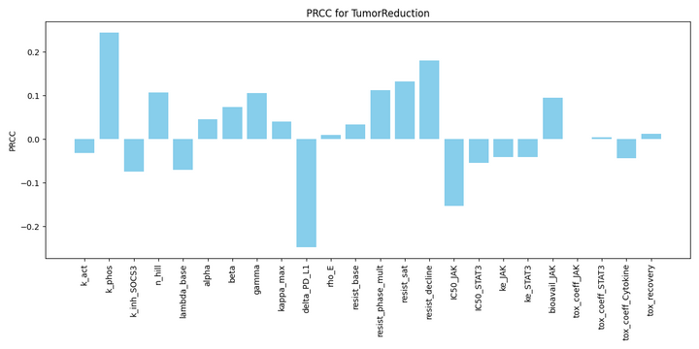
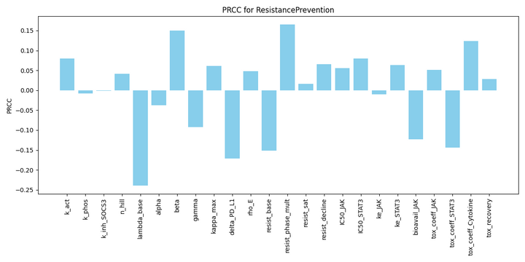
Result - Sensitivity of QSP Model
Key parameters that significantly influence treatment outcomes
PRCC Analysis:
  Immune preservation: SOCS3 inhibition rate (PRCC = 0.21), STAT phosphorylation rate (PRCC = 0.15), T cell proliferation rate (PRCC = -0.15)
  Resistance prevention: Hill coefficient (PRCC = -0.23), resistance phase multiplier (PRCC = 0.16), cyclin D1 influence coefficient (PRCC = 0.15)
  Toxicity minimization: Resistance phase multiplier (PRCC = 0.22), cytokine blocker toxicity coefficient (PRCC = 0.22), Hill coefficient (PRCC = 0.15)
  Tumor reduction: PD-L1 effect coefficient (PRCC = -0.25), STAT phosphorylation rate (PRCC = 0.23), resistance decline rate (PRCC = 0.18)
17

Slide 19
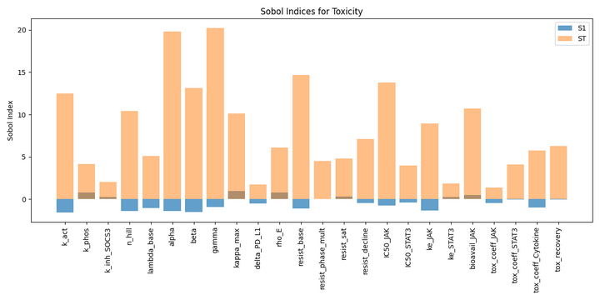
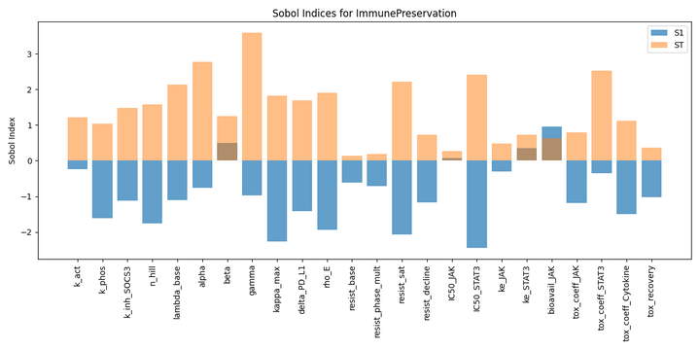
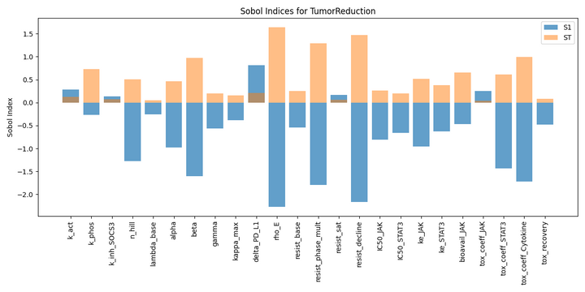
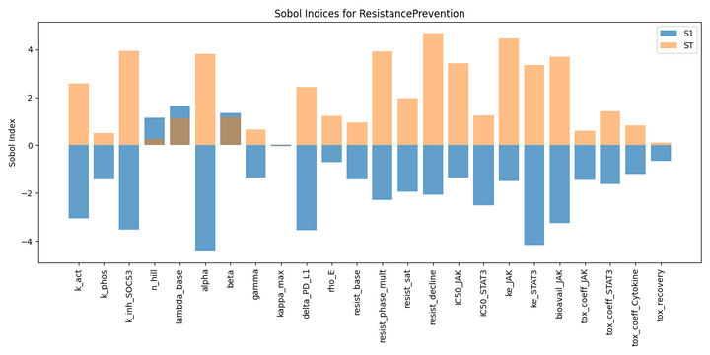
Result - Sensitivity of QSP Model
Key parameters that significantly influence treatment outcomes
Sobol Analysis:
  Revealed substantial interaction effects, particularly for toxicity and resistance prevention outcomes
  Parameters with high total effect indices included survival factor influence, resistance decline rate, and cytokine blocker toxicity coefficient
  Toxicity outcomes were dominated by parameter interactions rather than individual parameter effects
  Results indicated complex interdependencies within the model structure
Key take for future RL reward design:
  SOCS3 inhibition rate as critical control parameter across multiple objectives => priority for RL policy optimization.
  Complex parameter interactions dominate outcomes => multi-objective RL rather than simple parameter tuning approaches.
  Robust parameter rankings => informing RL state representation and reward function design.
18

Slide 20
Limitation & Prospects
Model Simplifications
  Integrate with pathway cross-talk, Immune cell diversity, Tumor heterogeneity, and Spatial considerations
  Context-dependence: Parameters like pathway activation rates can vary substantially across tissue types, tumor types, and individual patients.
  Temporal dynamics: Some parameters likely change over time due to disease progression or treatment effects, whereas our model treats most parameters as static.
Parameter Uncertainty
  High-throughput screening: Test predicted combinations in cell line panels and patient-derived organoids
  Mechanistic validation: Confirm pathway dynamics, resistance mechanisms, and immune interactions via phospho-flow and co-culture assays
  In vivo translation: Validate top strategies in syngeneic mouse models with biomarker development
Validation Limitations
19

Slide 21
Conclusion
Our approach successfully identified diverse treatment strategies representing different trade-offs between tumor reduction, immune preservation, resistance prevention, and toxicity minimization.
1
Our results reveal fundamental biological trade-offs in JAK/STAT3 targeting, particularly between tumor control and immune preservation, and suggest that different intervention strategies may be optimal depending on disease context and treatment priorities.
2
Sensitivity analysis identified key biological parameters that most significantly influence treatment outcomes, providing guidance for RL rewards design and potential biomarkers for further Bayesian PD precision dosing.
3
Drug development guidance: selecting drug combinations, Phase 1 dosing ranges, patient biomarkers, and designing adaptive trials balancing multiple objectives.
4
20

Slide 22


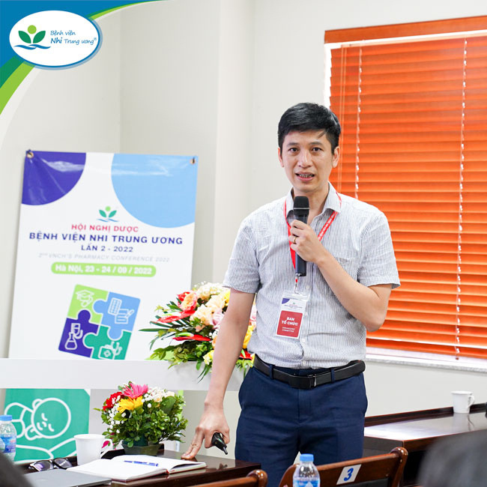
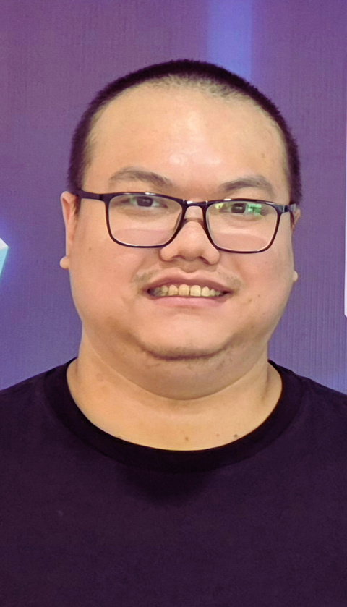

Our Team
Huge thanks to our amazing team!!!
LAP NGUYEN
NHUNG DUONG
HOA VU
TUAN DO
TIEN NGUYEN
21

Slide 23
Thank you!
Contact: nhung.duong@n2tp.com

