Slide 1
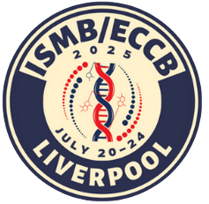

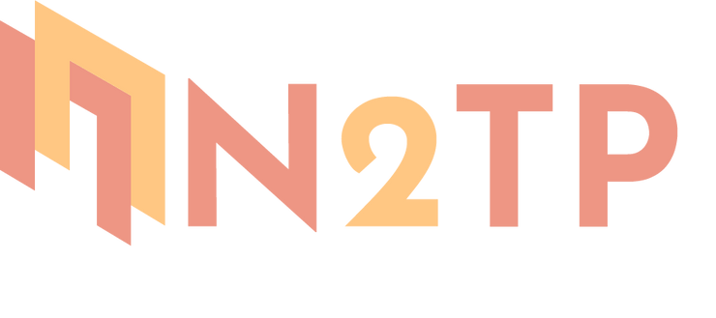

Multi-objective Reinforcement Learning for Optimizing JAK/STAT3 Pathway Interventions: A Computational Simulation Study
Nhung Duong, Tuan Do, Tien Nguyen, Hoa Vu, Lap Nguyen
From Hanoi University of Pharmacy, Vietnam
Presenter: Nhung Duong
Notes:
Good afternoon, everyone. It is my pleasure to be here on behalf of my team to present the research topic: “Multi-objective Reinforcement Learning for Optimizing JAK/STAT3 Pathway Interventions: A Computational Simulation Study.”

Slide 2
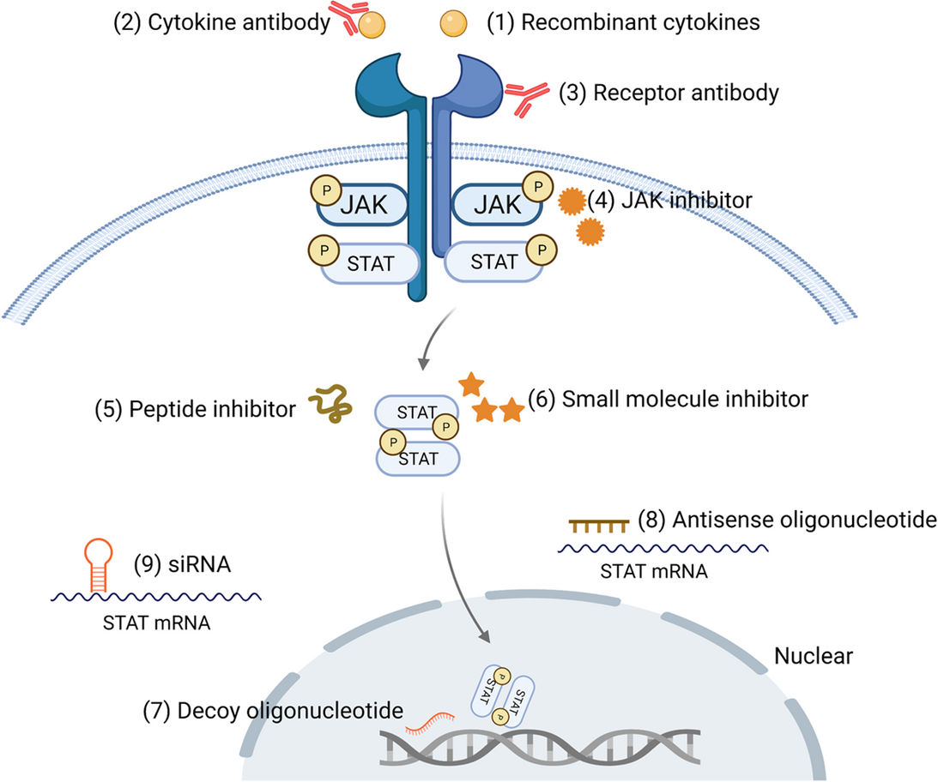
Background & Motivation
Drugs targeting JAK/STAT
  Cytokine or receptor antibodies
  JAK inhibitors
  STAT inhibitors
Figure from Hu, X., et al. Sig Transduct Target Ther 6, 402 (2021)
1
Notes:
JAK/STAT3 signaling pathway plays a critical role in cancer biology, influencing processes ranging from tumor cell proliferation and survival to immune evasion.
Several classes of JAK/STAT3 pathway inhibitors have been developed, including:

Slide 3
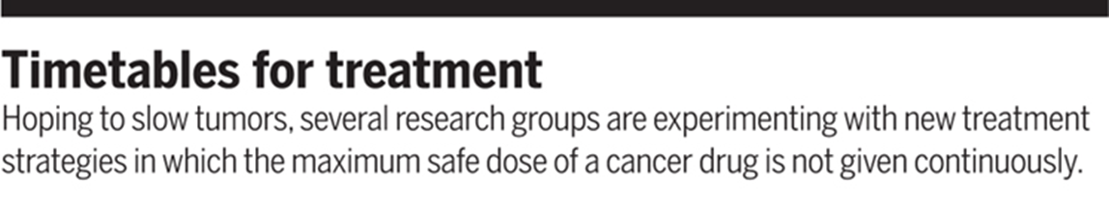
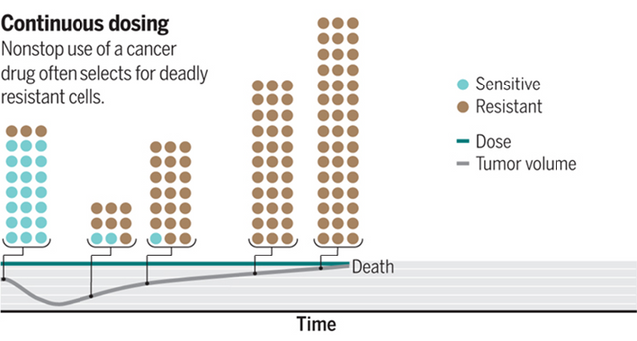
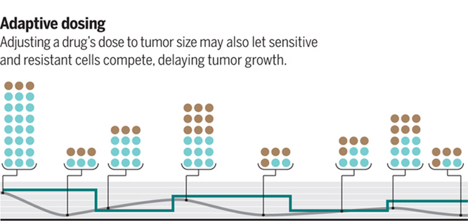
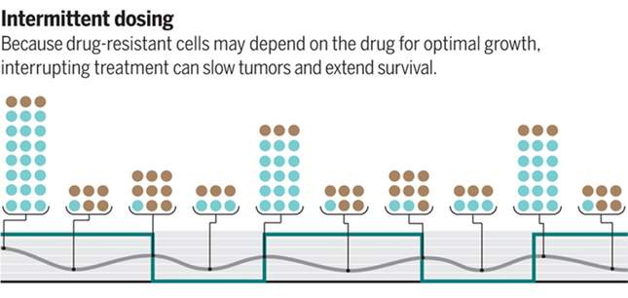
Background & Motivation
Challenges related to effective cancer treatment
  How combine effectively and safely?
  Because large number of potential drug combinations, variety of dosing schedules and sequences.
  Identifying the optimal treatment regimen among the countless possibilities seems an unreachable goal when using the standard empirical methods
2
Jocelyn Kaiser. Science 355,1144 1146(2017)
Notes:
However, how can we combine them effectively and safely?
Because we had a large number of potential drug combinations, and the variety of dosing schedules and sequences.
So, finding the best treatment among all the options seems impossible when we only use standard methods.

Slide 4
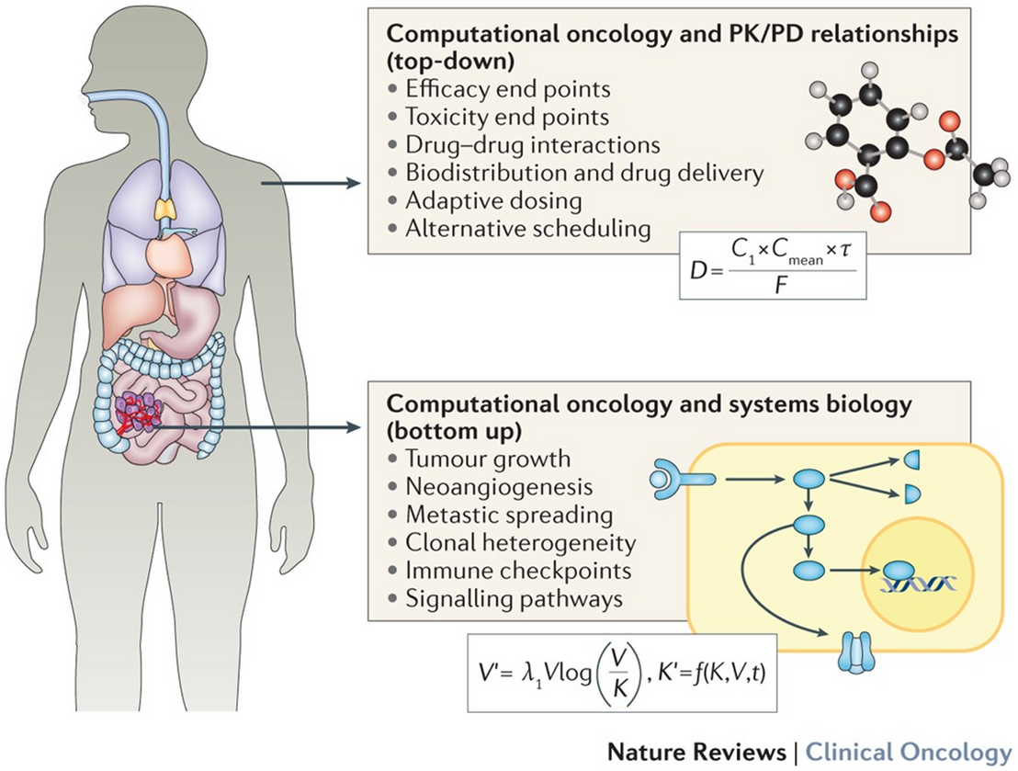
Background & Motivation
Computational approach to explore and screen Tx strategies
  Mechanistic models aim to investigate tumour biology (tumour growth, angiogenesis, metastasis, drug resistance...)
  PK/PD modelling to refine scheduling and dosing of anticancer
Methodological challenges: optimize multiple objective values simultaneously, represent different aspects of cancer Tx [Efficacy, Immune, Resistance, Toxicity]
Figure from Barbolosi, D., et al. Nat Rev Clin Oncol 13, 242–254 (2016)
3
Notes:
Computational approach holds potential to explore and screen Tx strategies for later experimental validation
It included mechanistic models to investigate tumour biology and PK/PD modelling to refine the scheduling and dosing of anticancer
However, it faces methodological challenges. Particularly, how can we optimize multiple objective values simultaneously, represent different aspects of cancer Tx, including Efficacy, Immune Preservation, Resistance Prevention, and Toxicity Minimization

Slide 5
Background & Motivation
A computational framework that applies multi-objective reinforcement learning to explore the JAK/STAT3 signaling network and identify promising intervention strategies
4
Notes:
That's why this study was conducted. We aim to develop a computational framework that applies multi-objective reinforcement learning to explore the JAK/STAT3 signaling network and identify promising intervention strategies

Slide 6
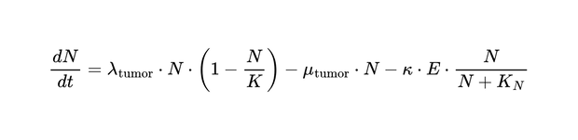
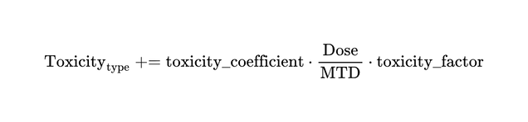
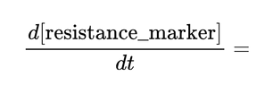
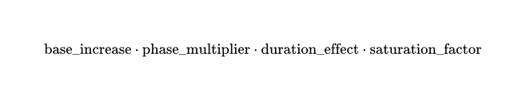
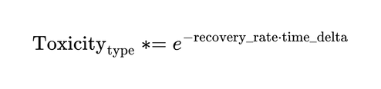
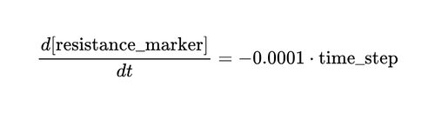
QSP Model
JAK/STAT Pathway Model
Cell Population Model
Intervention Model
System of ODE model:
  Ligand dynamics
  Receptor dynamics
  Ligand-receptor complex
  Receptor dimer
  JAK activation
  Active receptor-JAK complex
  STAT3 dynamics
  Phosphorylated STAT3
  STAT3 dimer in cytoplasm
  STAT3 dimer in nucleus
  mRNA and protein dynamics for target genes
Tumor-Immune Dynamical Model
PK/PD Model
  Incorporated cellular behaviors influenced by the JAK/STAT3 pathway outputs
  Consisted of Proliferation rate, Apoptosis rate, T cell dynamics, T cell killing rate, and T cell exhaustion dynamics:
  PK: One-compartment
  PD incorporated JAK inhibitor effect on JAK activation rate, STAT3 inhibitor effect on STAT3 phosphorylation, and cytokine blocker effect for ligand dynamics
Toxicity Model
Resistance Development Model
Toxicity Recovery Over Time:
During treatment off-periods, resistance declines passively:
5
Notes:
Our quantitative systems pharmacology (QSP) model integrates multiple components.
First, we have the JAK/STAT pathway model - a system of ordinary differential equations (ODE) capturing ligand binding, receptor dynamics, JAK activation, STAT phosphorylation, and target gene expression.
Second, the cell population model incorporates tumor-immune dynamics influenced by pathway outputs, including proliferation rates, apoptosis rate, and T cell dynamics.
Third, we model resistance development as a time-dependent process that increases with therapy intensity but can recover during treatment holidays.
Finally, our intervention model includes PK/PD for three drug types, along with organ-specific toxicity accumulation and recovery.

Slide 7
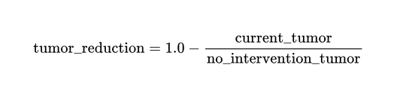
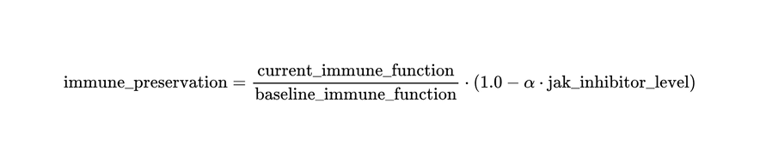
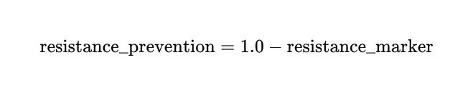
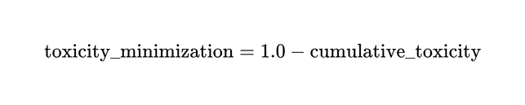
Objective Definition and Rationale
Definition
Tumor-Immune Dynamical Model
Rationale
Tumor-Immune Dynamical Model
  Clinical reality: Four objectives reflect real competing priorities in cancer therapy (efficacy vs. safety vs. resistance)
  Balanced optimization: [0,1] normalization prevents single metric dominance in reward function
  Pareto exploration: Five weight configurations systematically explore trade-offs between conflicting goals
  True efficacy: Tumor reduction vs. no-intervention baseline ensures rewards reflect treatment impact, not natural progression
  Addresses failure modes: Each objective targets specific clinical challenges (resistance, immunosuppression, toxicity discontinuation)
Resistance Prevention
Toxicity Minimization
Weight
  Balanced: w = [0.25, 0.25, 0.25, 0.25]
  Efficacy-focused: w = [0.7, 0.1, 0.1, 0.1]
  Immune-preserving: w = [0.1, 0.7, 0.1, 0.1]
  Resistance-preserving: w = [0.1, 0.1, 0.7, 0.1]
  Toxicity-minimizing: w = [0.1, 0.1, 0.1, 0.7]
6
Notes:
In order to run RL, we set four objectives that reflect real clinical priorities:
First, tumor reduction - comparing current tumor burden to what would occur without treatment. This ensures we're measuring true intervention impact.
Second, immune preservation - maintaining T cell function while accounting for JAK inhibitor immunosuppression, which is critical for long-term control.
Third, resistance prevention - rewarding strategies that delay or prevent resistance emergence.
Fourth, toxicity minimization - aggregating organ-specific toxicities to encourage tolerable regimens.
We trained five distinct RL agents with different weight configurations to explore the Pareto front - from balanced approaches to those prioritizing specific objectives. This lets us systematically identify trade-offs between these competing goals.

Slide 8
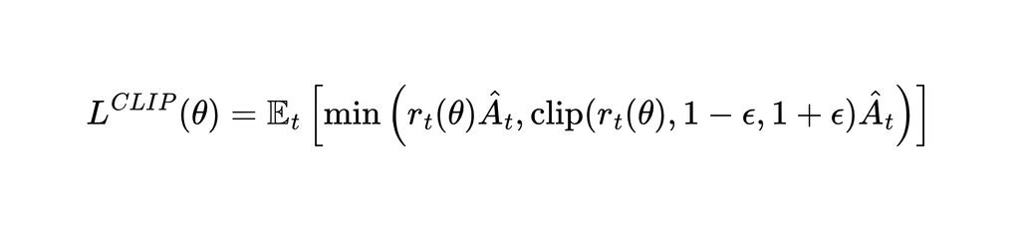


RL Methodology
Multi-objective Proximal Policy Optimization
A multi-objective reinforcement learning approach was implemented based on Proximal Policy Optimization (PPO)
The algorithm maintained 2 neural networks:
  Policy network πθ(a|s): Outputs action probabilities given the current state
  Value network Vϕ(s): Estimates the expected vector of rewards for each state
The PPO objective function for policy optimization is:
RL Training Parameters
  Environment: 100-day episodes using integrated mechanistic model as simulation environment
  State space: 32-dimensional vector
  Action space: Discrete multi-dimensional choice of 3 intervention types (JAKi, STAT3i, IL-6 antibody) combined with 5 dose levels (0-100% MTD)
  Training scale: 1,000,000 total environment steps
  Algorithm parameters: PPO with discount factor γ=0.99, learning rate 3×10⁻⁴
  Multi-objective approach: 5 distinct agents trained with different reward weight configurations to explore Pareto front
  Episode structure: Daily action selection over 100-day treatment periods
Where:
- is the probability ratio between the new and old policy
- is the advantage estimate, computed for each objective dimension
- is the clipping parameter (typically 0.1 or 0.2)
7
Notes:
For the technical details - we implemented multi-objective proximal policy optimization, or PPO. The algorithm maintains two neural networks: a policy network that outputs action probabilities and a value network that estimates expected rewards.
Our RL agents operate in 100-day episodes, choosing daily from 15 discrete actions - combinations of three drug types at five dose levels. The 32-dimensional state space captures pathway status, tumor metrics, immune markers, and toxicity levels.
We trained each agent for one million environment steps, using different reward weightings to explore diverse treatment strategies. This massive computational effort identified patterns that would be impossible to find experimentally

Slide 9
Sensitivity Analysis
One-At-a-Time (OAT) Analysis
PRCC Analysis
For each parameter θ, we defined a range of variation:
  Core pathway parameters: Varied by ±10%, ±20%, and ±50%
  Pharmacokinetic parameters: Varied by ±10%, ±20%, and ±50%
  Pharmacodynamic parameters: Varied by ±10%, ±25%, and ±75%
  Toxicity parameters: Varied by ±10%, ±30%, and ±60%
Each parameter was varied independently while all others were kept at their baseline values
  Generated 1000 param sets using Latin Hypercube Sampling
  From the LHS results, we calculated PRCC values to quantify the strength and direction of monotonic relationships while controlling for the effects of other parameters. The calculation involved:
    Ranking the parameter values and outcome metrics
    Computing the correlation matrices between parameters and outcomes
    Calculating partial correlation coefficients using these rank correlation matrices
Sobol Analysis
Why Sensitivities?
  Model confidence: Validates which of parameters actually drive outcomes
  Robustness: Ensures RL strategies aren't artifacts of specific parameter choices
  Biomarkers: Identifies parameters for patient stratification
  Priorities: Guides which parameters need experimental validation
  Future RL reward design: Informs parameter-aware reward design
We computed first-order (S1) and total (ST) Sobol indices using the SALib Python package. We generated 10,000 parameter samples using Saltelli's sampling scheme and simulated the model for each parameter set.
The indices were calculated for each of the four objective metrics.
8
Notes:
To ensure our results were robust, we performed comprehensive sensitivity analysis using three approaches:
One-at-a-time analysis varied parameters individually to identify key drivers. PRCC analysis quantified parameter influence while controlling for other variables. And Sobol analysis revealed important parameter interactions.
Why does this matter? It validates which parameters actually drive outcomes, ensures our RL strategies aren't artifacts of specific parameter choices, identifies potential biomarkers for patient stratification, and informs future reward design.

Slide 10
Result & Discussion
Reinforcement Learning Outcomes
9

Slide 11
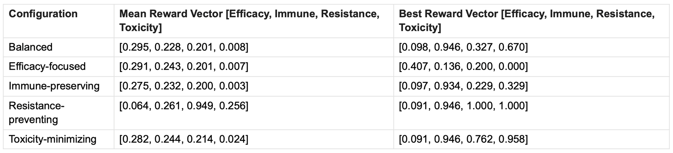
Result & Discussion - RL Outcomes
Attaining high performance in four objectives simultaneously seems impractical
Performance summary for different objective weight configurations:
  Trade-off: Differences between the mean and best reward vectors => inherent conflicts between objectives
  Objective Prioritization: Weight configurations <-> Emphasized objectives
  Toxicity Challenge: Toxicity minimization consistently showed the lowest values
  Exceptional Solutions: Notable strategy [resistance prevention and toxicity minimization
  Immune-Tumor Coupling: High immune preservation with limited tumor reduction
10
Notes:
Here's our first key finding - achieving high performance across all four objectives simultaneously is essentially impossible. Look at the differences between mean and best reward vectors - they reveal fundamental biological trade-offs.
The efficacy-focused agent achieved 40% tumor reduction but at the cost of severe toxicity. The resistance-preventing agent achieved perfect resistance and toxicity scores but only 6% tumor reduction.
Notice how toxicity minimization consistently shows the lowest values - this highlights the challenge of maintaining low toxicity while achieving other objectives.
However, we did find exceptional solutions, particularly this resistance-preventing strategy that scored perfectly on both resistance and toxicity.

Slide 12
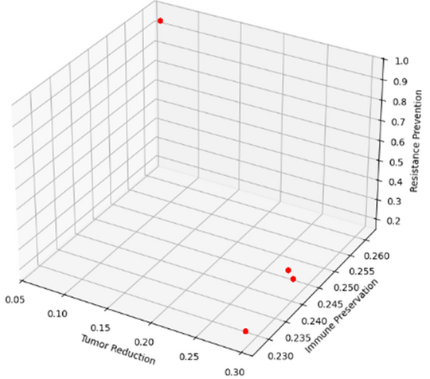
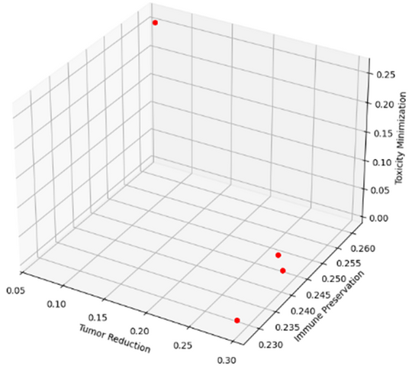
Result & Discussion - Pareto
But we can identify a set of optimal intervention strategies
Clustered strategies in distinct regions of the objective space, representing qualitatively different treatment paradigms:
  High Immune Preservation Cluster: immune preservation values >0.94 with limited tumor reduction (0.05-0.10) but varied considerably in resistance prevention (0.2-0.95) and toxicity minimization (0.25-1.0).
  High Tumor Reduction Cluster: achieved tumor reduction values >0.25, but sacrificed resistance prevention (≤0.2) and toxicity profiles (≤0.02).
  Balanced Strategies: Achieved moderate performance across all objectives (all values ~0.2-0.3).
  Exceptional Points: Outlier strategies achieved near-optimal performance in three objectives simultaneously, especially scoring perfectly on resistance prevention and toxicity minimization.
11
Notes:
Although attaining high performance in four objectives simultaneously seems impractical, we can identify a set of optimal intervention strategies
We first clustered interventional strategies in distinct regions of the objective space, representing qualitatively different treatment paradigms. This included
1. High Immune Preservation Cluster: immune preservation values >0.94 with limited tumor reduction (0.05-0.10) but varied considerably in resistance prevention (0.2-0.95) and toxicity minimization (0.25-1.0).
2. High Tumor Reduction Cluster: achieved tumor reduction values >0.25, but sacrificed resistance prevention (≤0.2) and toxicity profiles (≤0.02).
3. Balanced Strategies: Achieved moderate performance across all objectives (all values ~0.2-0.3).
4. Exceptional Points: Outlier strategies achieved near-optimal performance in three objectives simultaneously, especially scoring perfectly on resistance prevention and toxicity minimization.
We then selected these strategies for futher exploration.

Slide 13
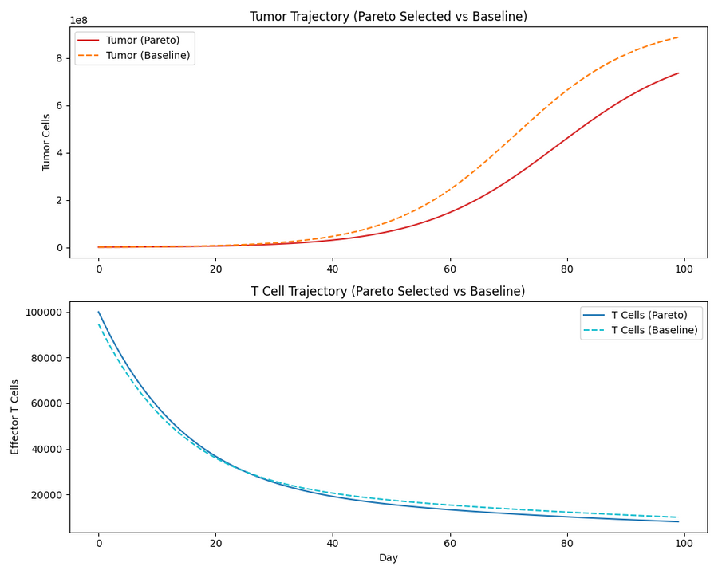
Result & Discussion - Pareto Optimal
Tumor-reduction prioritizing strategy
The intervention schedule consisted of:
  Moderate-dose JAK inhibitor (~40% MTD)
  High-dose STAT3 inhibitor (~90-100% MTD)
  Pulsed low-dose cytokine blocker with regular drug holidays
This strategy [0.282, 0.244, 0.214, 0.024] balanced moderate tumor reduction with reasonable immune preservation while accepting higher toxicity as a trade-off
  28% reduction in tumor volume compared to baseline after 100 days of treatment
  T cell counts were maintained at approximately 24% of baseline levels after adjusting for JAK inhibitor effects
  Significant cumulative toxicity
12
Notes:
Let's examine a specific Pareto-optimal strategy that prioritizes tumor reduction. This approach uses continuous moderate-dose JAK inhibitor, high-dose STAT inhibitor, and pulsed cytokine blocker with drug holidays.
The results? 28% tumor reduction after 100 days - clinically meaningful. T cells maintained at 24% of baseline - concerning but manageable. However, significant cumulative toxicity limits long-term use.
The graphs show tumor trajectory compared to no treatment, and T cell dynamics over time. This represents an aggressive approach suitable for advanced disease where immediate response is critical.

Slide 14
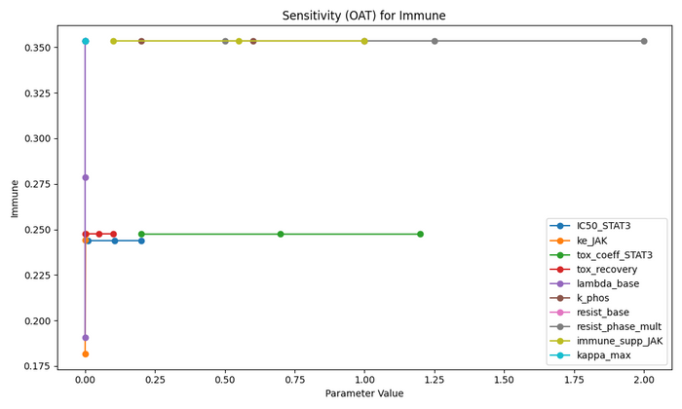
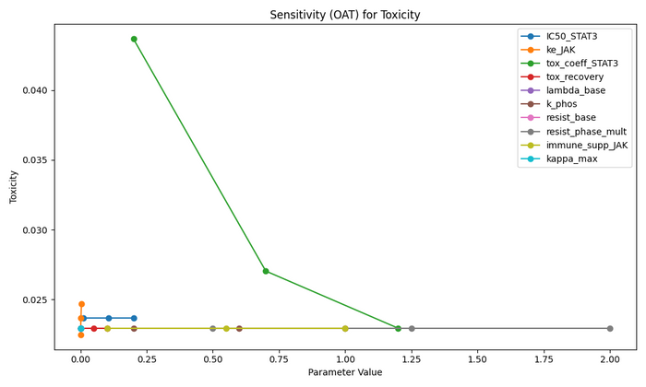
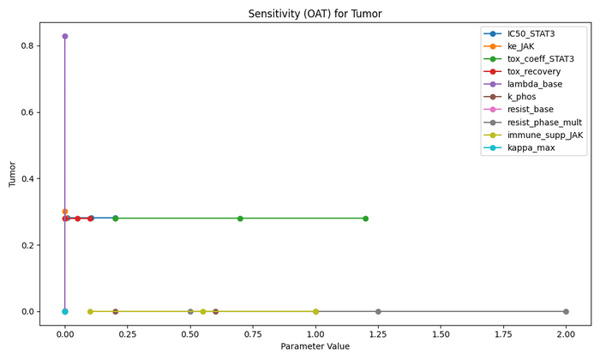
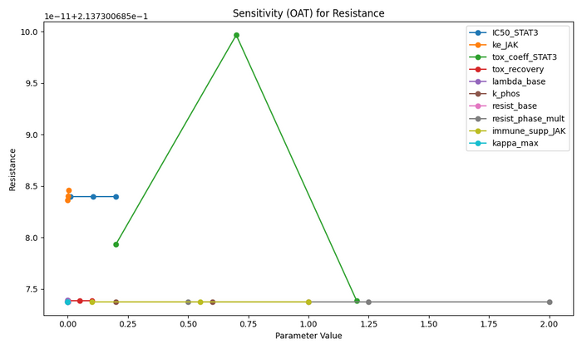
Result & Discussion - Pareto Optimal
Tumor-reduction prioritizing strategy - One-At-a-Time (OAT) sensitivity analysis
  Tumor reduction - most sensitive to baseline tumor proliferation rate, with higher values dramatically improving control.
  Immune preservation was primarily influenced by JAK inhibitor immune suppression factor and resistance phase multiplier, with elimination rate showing moderate impact.
  Resistance prevention showed non-monotonic response to STAT inhibitor toxicity coefficient, peaking at intermediate values.
  Toxicity minimization was predominantly controlled by STAT inhibitor toxicity coefficient, with higher values paradoxically improving scores through complex parameter interactions.
The Pareto-optimal strategy is robust to most parameter variations, though patient-specific tumor growth and STAT inhibitor response factors could significantly impact outcomes.
13
Notes:
Our sensitivity analysis revealed which parameters most influence this strategy's success. Tumor reduction was highly sensitive to baseline proliferation rate - faster-growing tumors actually respond better to this approach.
Immune preservation depended critically on JAK inhibitor effects and resistance phase multipliers. Interestingly, resistance prevention showed non-monotonic behavior with STAT inhibitor toxicity - there's an optimal middle ground.
The key message? This Pareto-optimal strategy is generally robust, but patient-specific factors like tumor growth rate and STAT inhibitor response could significantly impact outcomes. This points toward personalized medicine applications.

Slide 15
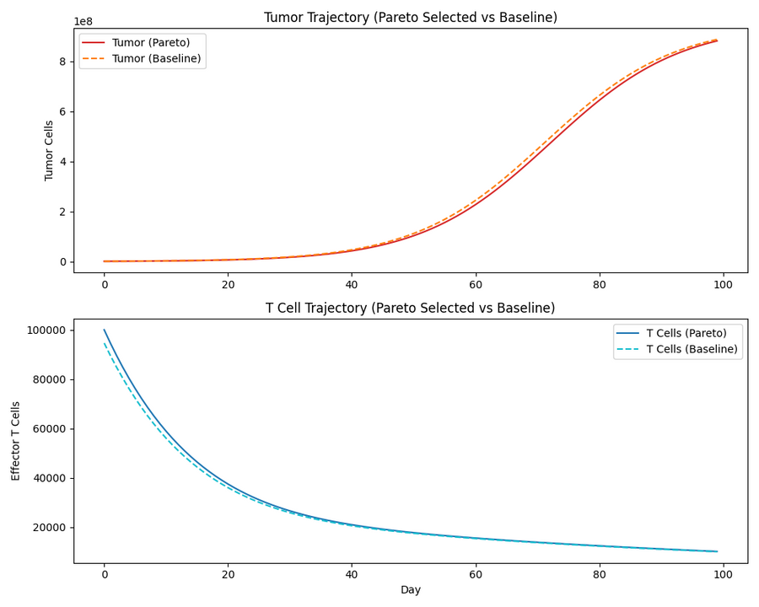
Result & Discussion - Pareto Optimal
Resistence prevention prioritizing strategy
The intervention schedule consisted of:
  Minimal JAK and STAT3 inhibition with pulsed very low-dose cytokine blocker administration
This strategy [0.064, 0.261, 0.949, 0.256] exchanged tumor control for exceptional resistance prevention
  Prevented the emergence of resistant cell populations (0.949 score)
  Maintained better toxicity profile (0.256 vs 0.024)
  Achieved slightly better immune preservation (0.261 vs 0.244)
  Sacrificed significant tumor control (only 6.4% reduction)
14
Notes:
Now contrast this with a completely different approach - the resistance prevention strategy. Using minimal JAK and STAT inhibition with very low-dose cytokine blocker, this gentle approach achieved remarkable results:
94% resistance prevention score, better toxicity profile, slightly better immune preservation, but only 6.4% tumor reduction.
This represents a paradigm shift - accepting slower tumor control to maintain treatment options long-term. It could be ideal for maintenance therapy, early-stage disease, or patients at high risk for resistance development.

Slide 16
Result & Discussion
QSP Model Sensitivity Analyses
15

Slide 17
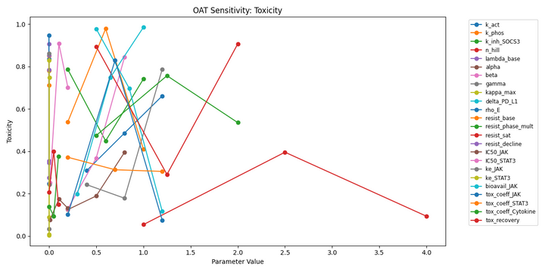
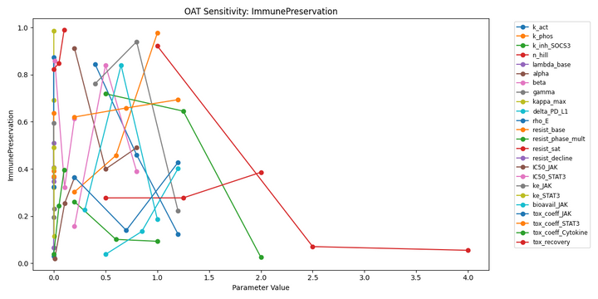
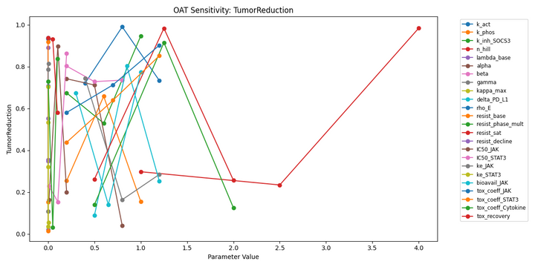
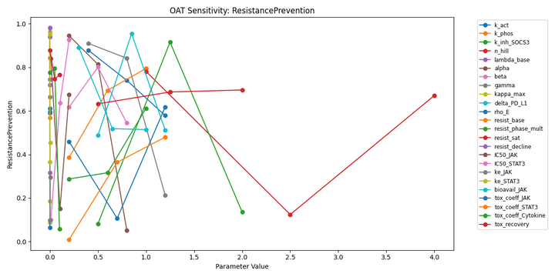
Result - Sensitivity of QSP Model
Key parameters that significantly influence treatment outcomes
One-At-a-Time Analysis:
  Immune preservation was most sensitive to SOCS3 inhibition rate and resistance saturation
  Resistance prevention showed significant sensitivity to SOCS3 inhibition rate and base resistance development rate
  Toxicity outcomes were particularly influenced by toxicity recovery rate and JAK inhibitor bioavailability
  Tumor reduction was most affected by toxicity recovery rate and JAK activation rate
16
Notes:
Đọc slide

Slide 18
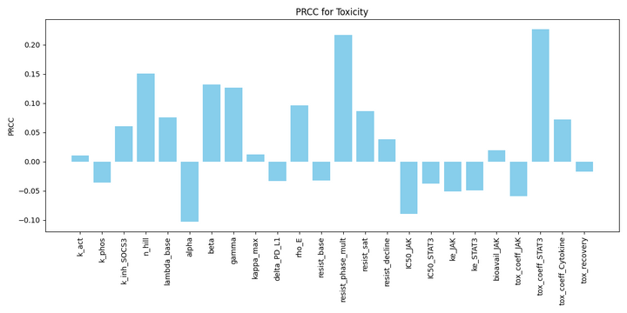
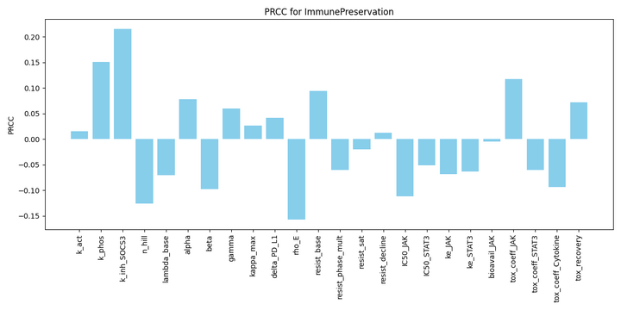
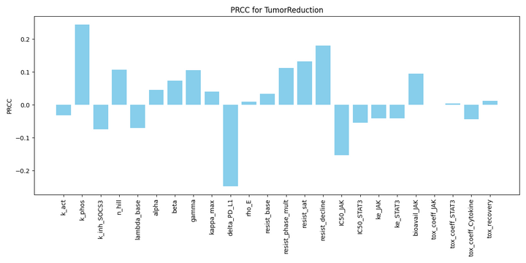
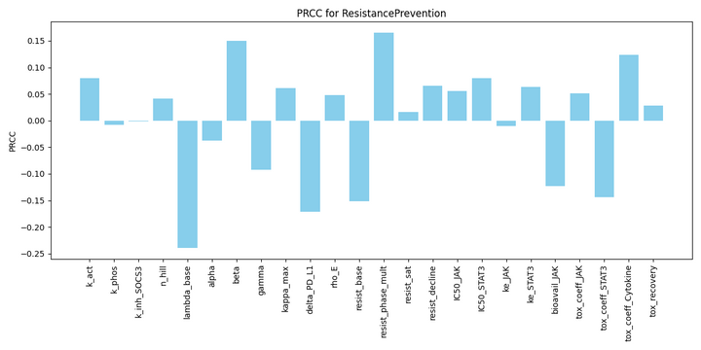
Result - Sensitivity of QSP Model
Key parameters that significantly influence treatment outcomes
PRCC Analysis:
  Immune preservation: SOCS3 inhibition rate (PRCC = 0.21), STAT phosphorylation rate (PRCC = 0.15), T cell proliferation rate (PRCC = -0.15)
  Resistance prevention: Hill coefficient (PRCC = -0.23), resistance phase multiplier (PRCC = 0.16), cyclin D1 influence coefficient (PRCC = 0.15)
  Toxicity minimization: Resistance phase multiplier (PRCC = 0.22), cytokine blocker toxicity coefficient (PRCC = 0.22), Hill coefficient (PRCC = 0.15)
  Tumor reduction: PD-L1 effect coefficient (PRCC = -0.25), STAT phosphorylation rate (PRCC = 0.23), resistance decline rate (PRCC = 0.18)
17
Notes:
đọc slide

Slide 19
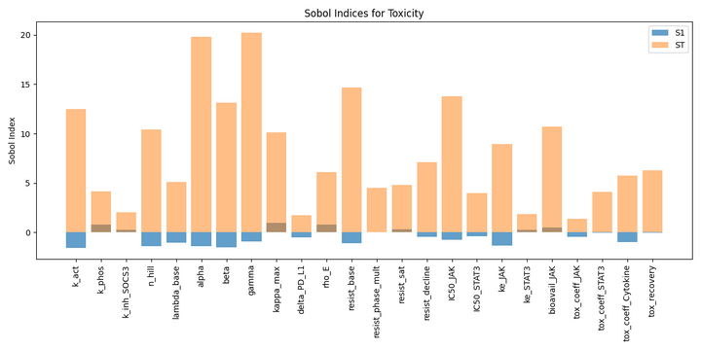
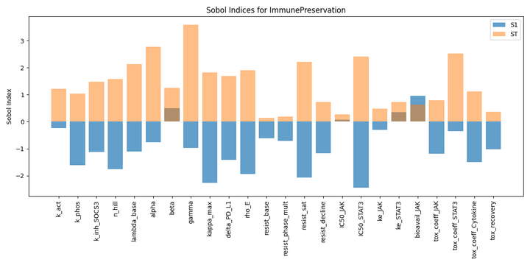
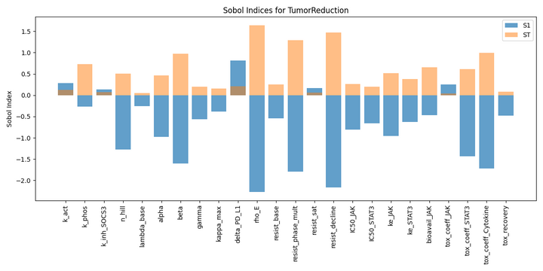
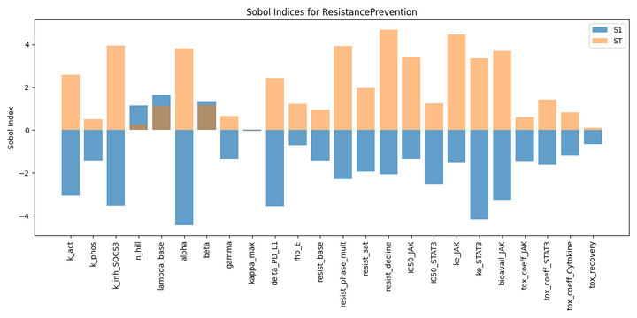
Result - Sensitivity of QSP Model
Key parameters that significantly influence treatment outcomes
Sobol Analysis:
  Revealed substantial interaction effects, particularly for toxicity and resistance prevention outcomes
  Parameters with high total effect indices included survival factor influence, resistance decline rate, and cytokine blocker toxicity coefficient
  Toxicity outcomes were dominated by parameter interactions rather than individual parameter effects
  Results indicated complex interdependencies within the model structure
Key take for future RL reward design:
  SOCS3 inhibition rate as critical control parameter across multiple objectives => priority for RL policy optimization.
  Complex parameter interactions dominate outcomes => multi-objective RL rather than simple parameter tuning approaches.
  Robust parameter rankings => informing RL state representation and reward function design.
18
Notes:
đọc slide
Kết => These robust parameter rankings inform both clinical biomarker development and future RL system design. We now know which biological measurements would be most valuable for personalizing treatment.

Slide 20
Limitation & Prospects
Model Simplifications
  Integrate with pathway cross-talk, Immune cell diversity, Tumor heterogeneity, and Spatial considerations
  Context-dependence: Parameters like pathway activation rates can vary substantially across tissue types, tumor types, and individual patients.
  Temporal dynamics: Some parameters likely change over time due to disease progression or treatment effects, whereas our model treats most parameters as static.
Parameter Uncertainty
  High-throughput screening: Test predicted combinations in cell line panels and patient-derived organoids
  Mechanistic validation: Confirm pathway dynamics, resistance mechanisms, and immune interactions via phospho-flow and co-culture assays
  In vivo translation: Validate top strategies in syngeneic mouse models with biomarker development
Validation Limitations
19
Notes:
Of course, our work has limitations. We simplified pathway cross-talk, aggregated immune cell types, and ignored spatial considerations. Parameters vary across patients and time, which our static model doesn't capture. And crucially, we need experimental validation.
But these limitations point to exciting future directions - more detailed models, patient-specific parameterization, and clinical validation studies.

Slide 21
Conclusion
Our approach successfully identified diverse treatment strategies representing different trade-offs between tumor reduction, immune preservation, resistance prevention, and toxicity minimization.
1
Our results reveal fundamental biological trade-offs in JAK/STAT3 targeting, particularly between tumor control and immune preservation, and suggest that different intervention strategies may be optimal depending on disease context and treatment priorities.
2
Sensitivity analysis identified key biological parameters that most significantly influence treatment outcomes, providing guidance for RL rewards design and potential biomarkers for further Bayesian PD precision dosing.
3
Drug development guidance: selecting drug combinations, Phase 1 dosing ranges, patient biomarkers, and designing adaptive trials balancing multiple objectives.
4
20
Notes:
To conclude: First, we successfully identified diverse treatment strategies with different trade-offs using multi-objective RL.
Second, we revealed fundamental biological trade-offs in JAK/STAT targeting - you can't optimize everything simultaneously.
Third, our sensitivity analysis identified key parameters that could serve as biomarkers for treatment personalization.
This work demonstrates how AI can help us navigate the complexity of cancer treatment, finding non-obvious strategies that balance multiple clinical objectives.

Slide 22


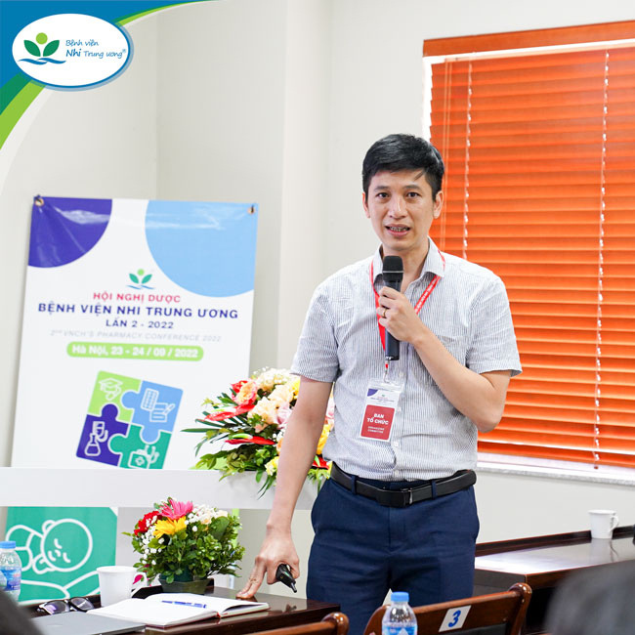
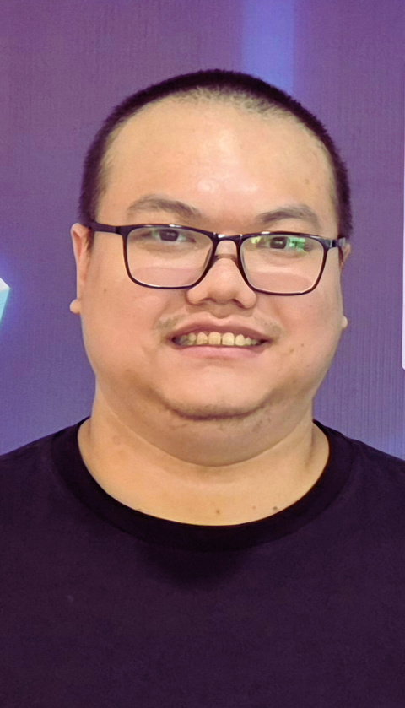

Our Team
Huge thanks to our amazing team!!!
LAP NGUYEN
NHUNG DUONG
HOA VU
TUAN DO
TIEN NGUYEN
21
Notes:
To conclude: First, we successfully identified diverse treatment strategies with different trade-offs using multi-objective RL.
Second, we revealed fundamental biological trade-offs in JAK/STAT targeting - you can't optimize everything simultaneously.
Third, our sensitivity analysis identified key parameters that could serve as biomarkers for treatment personalization.
This work demonstrates how AI can help us navigate the complexity of cancer treatment, finding non-obvious strategies that balance multiple clinical objectives.

Slide 23
Thank you!
Contact: nhung.duong@n2tp.com
Notes:
Thank you so much for listening. I hope to receive your comments and suggestions.

